Slide 1
Task Scheduler Comparison
Devan W. Eastman-Pittam and Ben F. Miller

Slide 2
Problem Statement
Our problem that we were trying to solve was to see which task scheduling algorithm was the best to use among the; “Shortest Remaining Time”, “Round Robin”, and the “Priority Based” task scheduling algorithms. We used 2 Main Metrics and 4 sub metrics to complete this task; the first 2 are the main metrics and the last 4 are the sub metrics, First was Average Turnaround Time in milliseconds, next was Average Times Processes Swapped, then Average Turnaround Time for Fast,Slow, Long, And lastly Short Tasks.

Slide 3
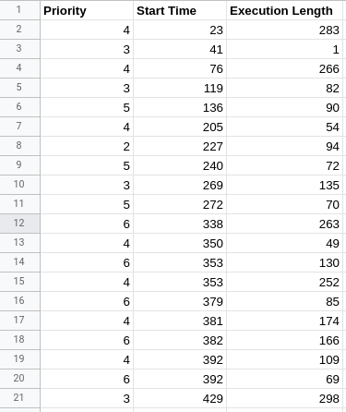
Sample Data Inputs
Priority Has 1 the highest and 6 the lowest for our Program
Priority and amount of tasks can be changed freely
Execution Length is total amount of time (in ms) to complete

Slide 4
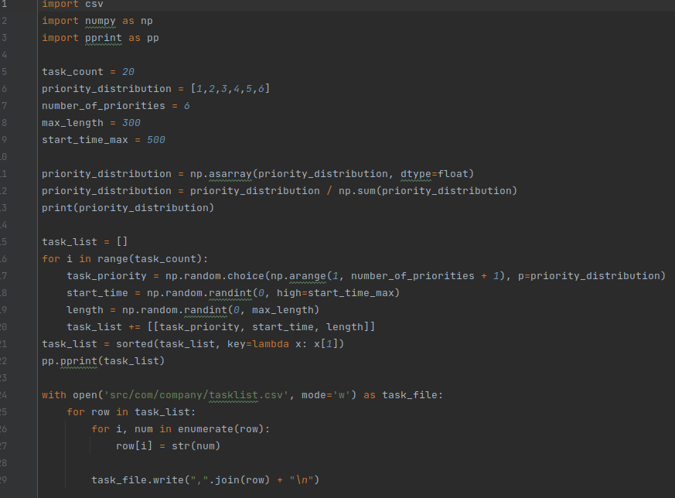
Data Generation

Slide 5
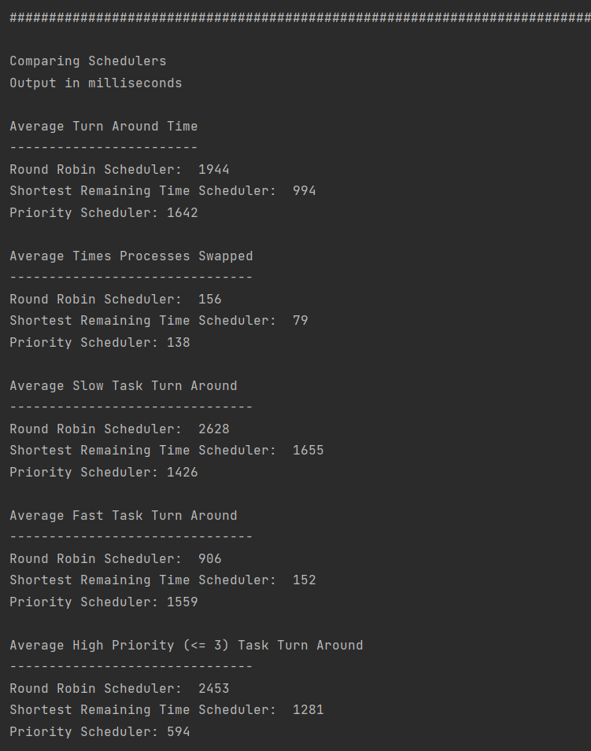
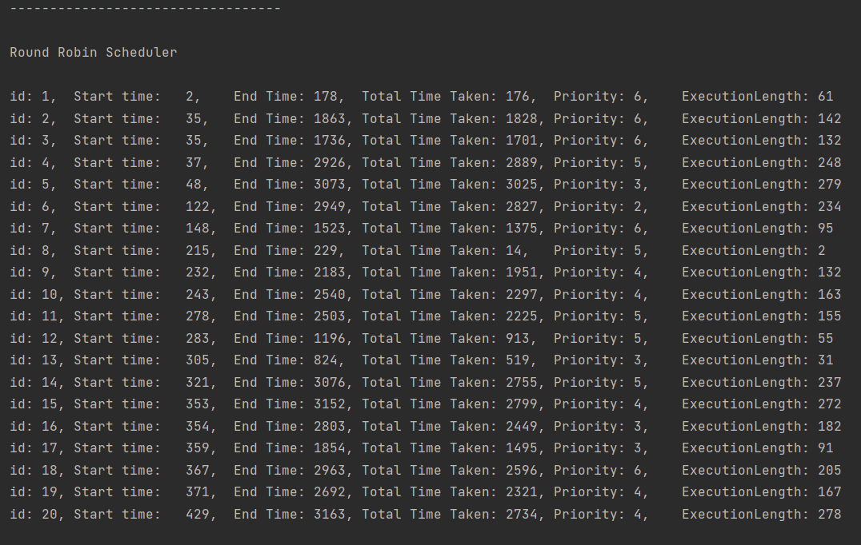
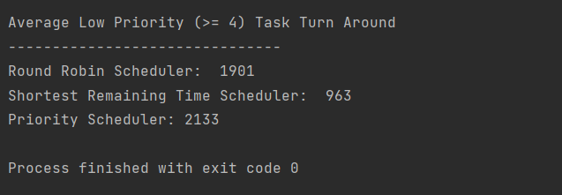
Example Data Outputs

Slide 6
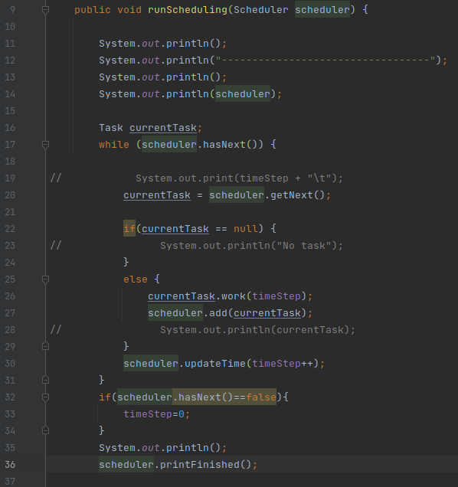
Run Scheduling
While there are tasks, the program
gets the next task, works it, and adds
it back to the scheduler.
When there are no more tasks,
the scheduling is printed and exited.

Slide 7

Common Algorithm Functions
Load Scheduler()
updateTime()
hasNext()
add()

Slide 8

Alg 1: Round Robin
The Round Robin Scheduler consists of a simple queue.
Pro: No priorities are taken into account, so all tasks are worked on equally. The execution time is relatively stable for each type of task and is determined by the total number of active tasks.
Con: Significantly raises individual task time taken to completion, the least amount of control on order of completion of tasks among all 3 algorithms.

Slide 9
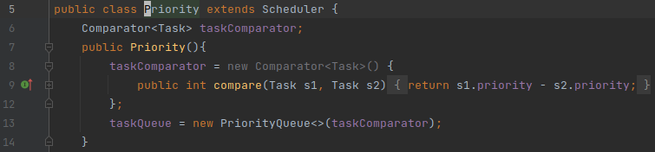
Alg 2: Highest Priority
Priority Scheduler uses a priority queue based on the task priority.
Pro: This method can quickly implement the tasks deemed the most urgent and prevent their delay in the most efficient method possible, affords more control to the judgement of which tasks should be done in which order.
Con: May cause low time remaining tasks to indefinitely delay completion, If you have many jobs of different priority the program might be delayed due to time taken to switch to the different tasks.

Slide 10
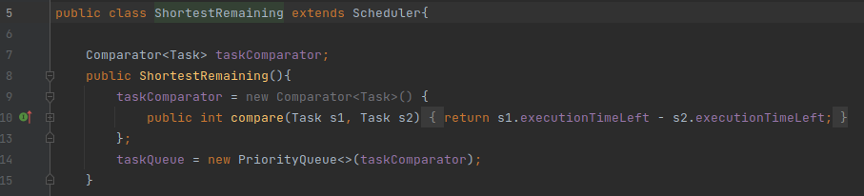
Alg 3: Shortest Remaining Time
The Shortest Remaining Time scheduler uses a priority queue based on execution time left.
Pro: Prioritizes tasks with low remaining times, so fast jobs finish quickly. Not very computationally hard to calculate the next job.
Con: Longer tasks are only worked on when there are no shorter tasks, so longer jobs can take a very long time to complete. Requires a way to calculate the estimated length.

Slide 11
Other Algorithms and Factors
Algorithms
First Come First Serve Scheduling (FCFS)
Multilevel Queue Scheduling
Multilevel Feedback Scheduling
Multiprocessor Scheduling
Factors
Multiple Processors
IO
Load Balancing
Affinity
(UKEssays)

Slide 12
Metrics Overview
Turnaround Time = Waiting Time in Ready Queue + Executing Time
Processes Swapped = number of times a process a process is worked on after a different process
Average Turnaround Time
Average Times Processes Swapped
Average Turnaround Time for Slow Process
Average Turnaround Time for Fast Process
Average Turnaround Time for High Priority Process (<=3)
Average Turnaround Time for Low Priority Process (>=4)

Slide 13
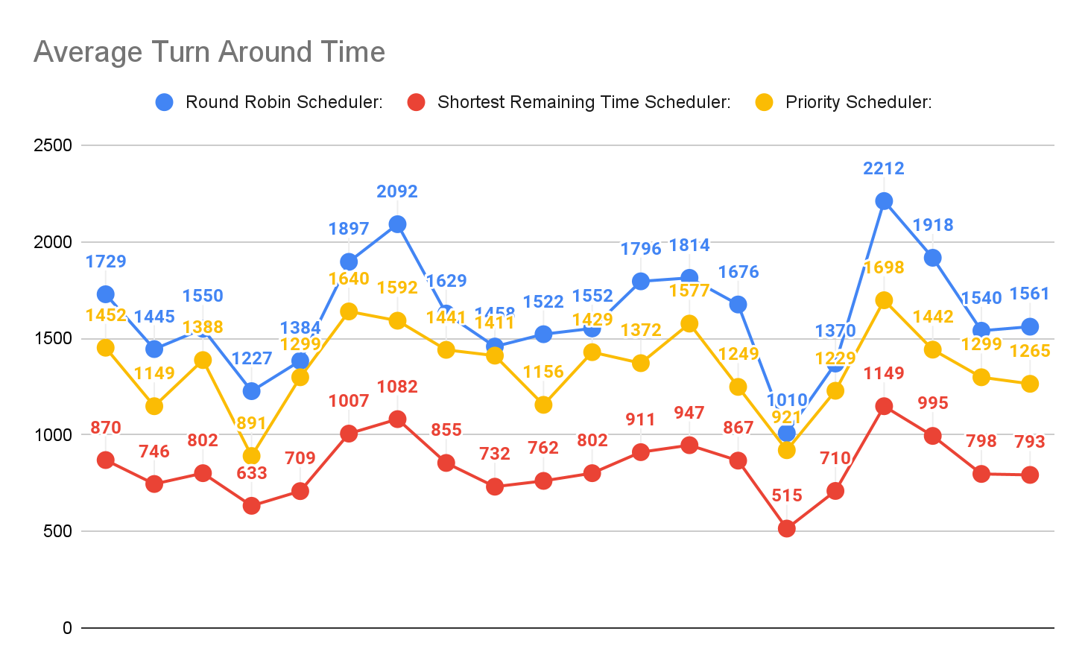
Metric 1: Average TurnAround Time in ms

Slide 14
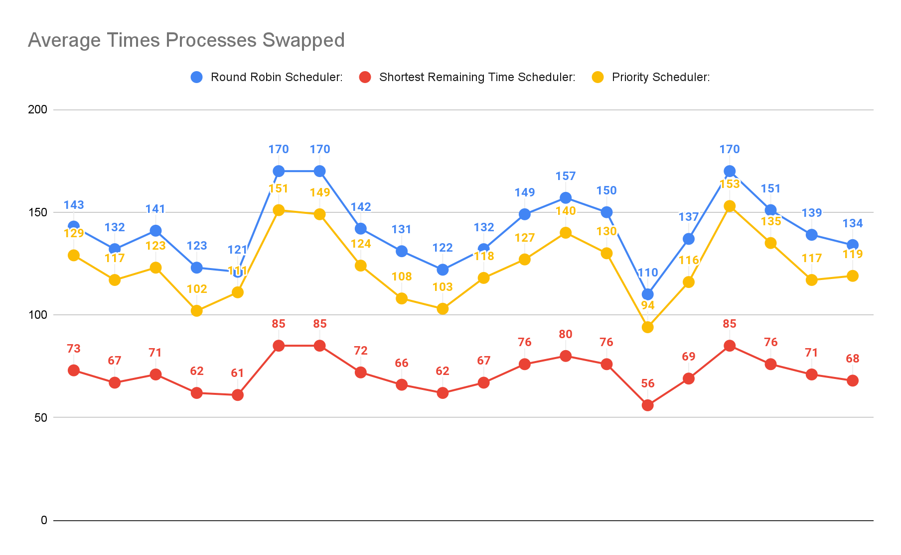
Metric 2: Average Times Processes Swapped

Slide 15
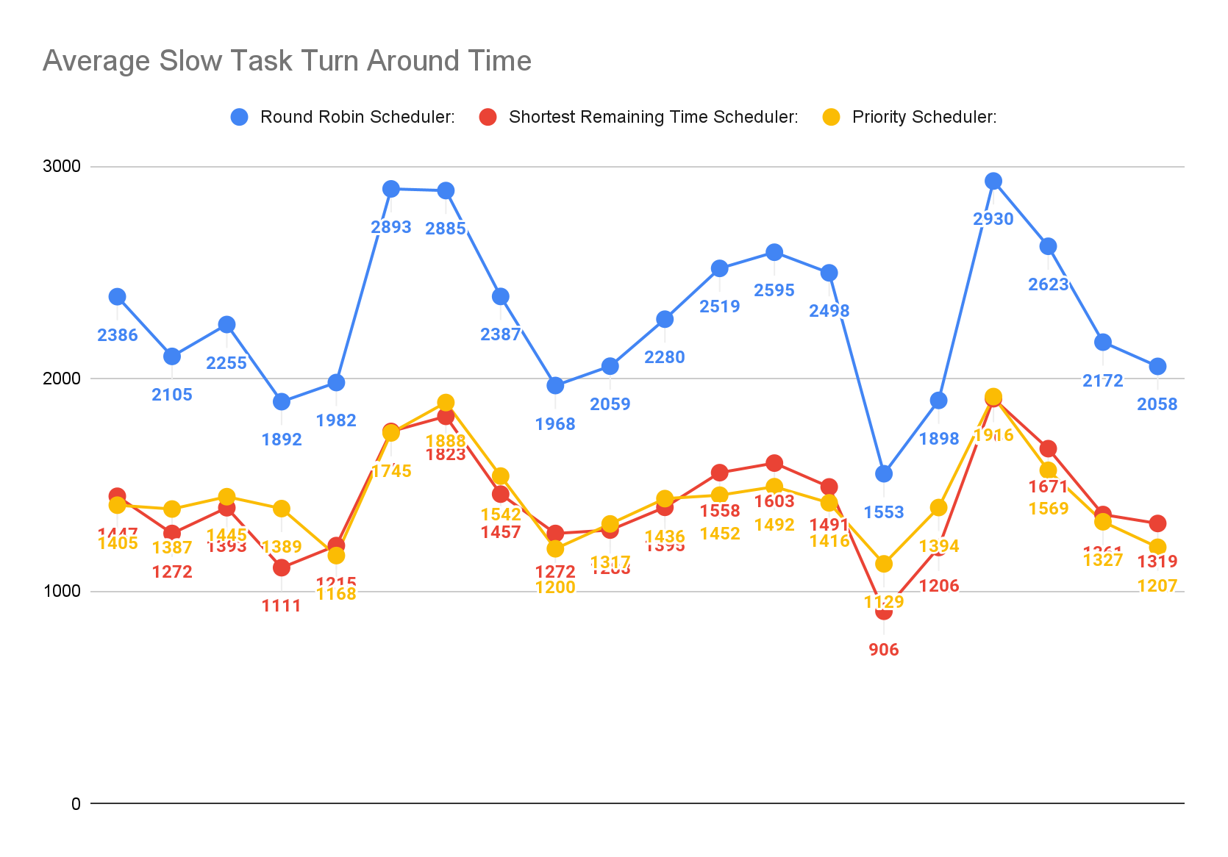
Metric 3: Average Slow Task TurnAround Time in ms

Slide 16
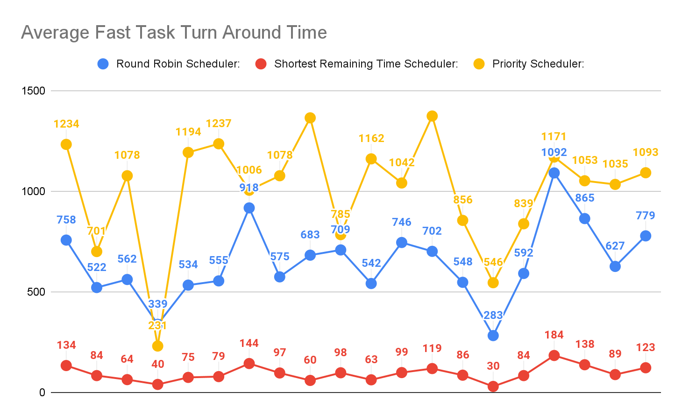
Metric 4: Average Fast Task TurnAround Time in ms

Slide 17
Comparison of Slow Vs Fast Task TurnAround time in ms

Slide 18
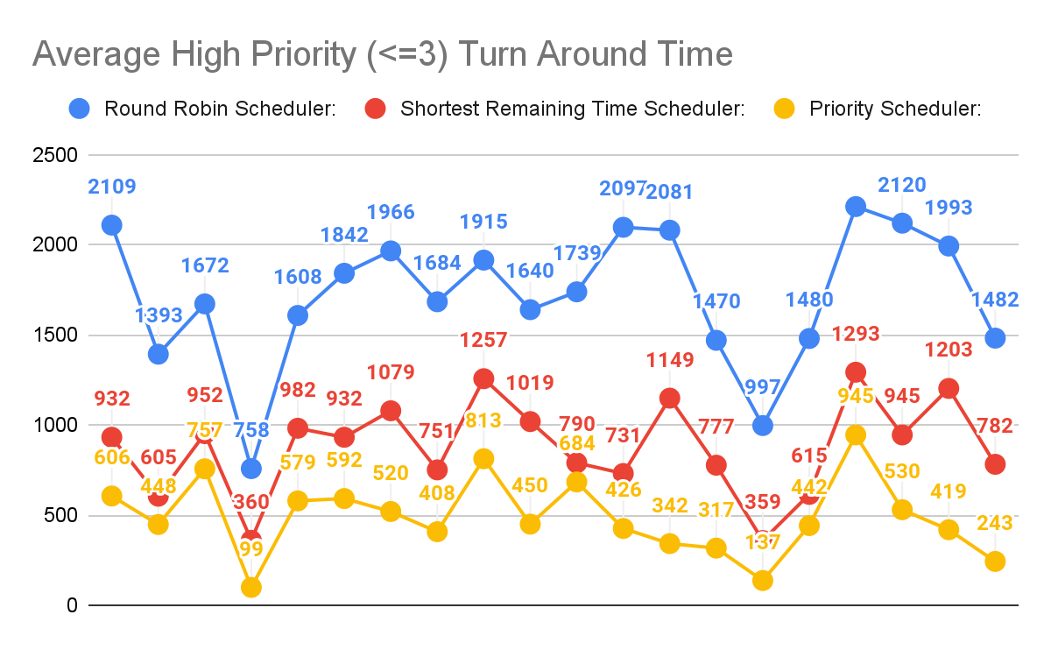
Metric 5: Average High Priority (<=3) Task TurnAround Time in ms

Slide 19
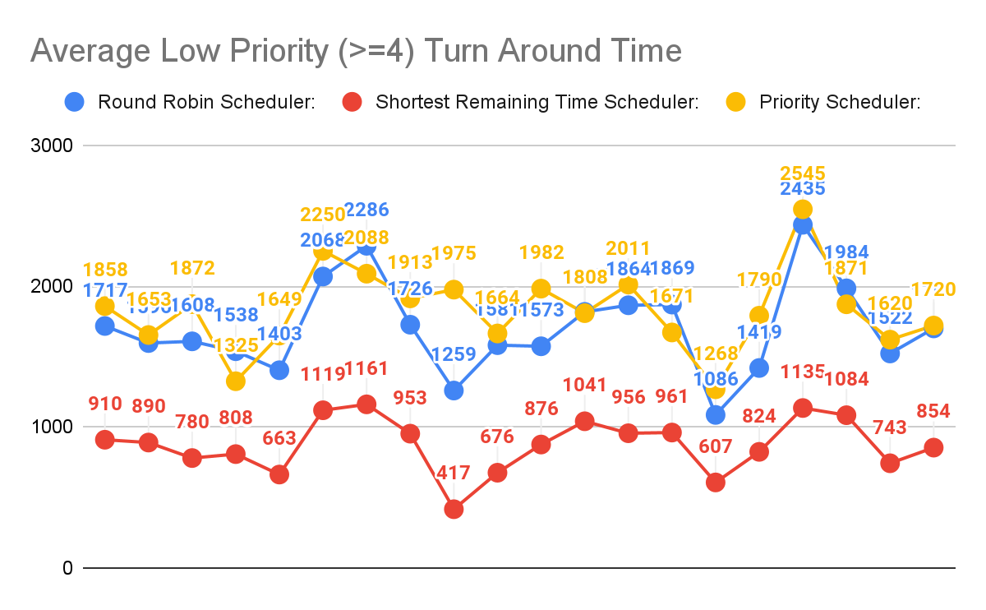
Metric 6: Average Low Priority (>=4) Task TurnAround Time in ms

Slide 20
Comparison of High Priority vs. Low Priority Task TurnAround time in ms

Slide 21
References
Os priority scheduling - javatpoint. www.javatpoint.com. (n.d.). Retrieved November 23, 2021, from https://www.javatpoint.com/os-priority-scheduling.
Os Round Robin Scheduling Algorithm - javatpoint. www.javatpoint.com. (n.d.). Retrieved November 23, 2021, from https://www.javatpoint.com/os-round-robin-scheduling-algorithm.
OS SRTF scheduling algorithm - javatpoint. www.javatpoint.com. (n.d.). Retrieved November 23, 2021, from https://www.javatpoint.com/os-srtf-scheduling-algorithm.
Williams, L. (2021, October 6). CPU scheduling algorithms in operating systems. Guru99. Retrieved November 23, 2021, from https://www.guru99.com/cpu-scheduling-algorithms.html.
UKEssays. (November 2018). A Comparison of CPU Scheduling. Retrieved from https://www.ukessays.com/essays/computer-science/a-comparison-of-cpu-scheduling.php?vref=1

